Slide 1

My Coordinate Geometry Interactive Notebook
Name
Class
Term 4 Semester 2

Slide 2
Contents
Formula Page
Page
Date
Description

Slide 3
Tasks
24
7
30
Essential Question
Questions
Notes
Summary

Slide 4
24
7
30
Date
Gradient, Distance & Midpoint
EQ – Describe how the gradient, distance & midpoint between two points are calculated using formulae?

Slide 5
The Gradient Formula
Let A (x₁ , y₁ ) and B (x₂ , y₂ ) be any two points on the Cartesian Plane. We normally use the point on the left side as (x₁ , y₁ )
y₂
C
(x₂ – x₁)
• B (x₂ , y₂ )
The gradient of the line AB can be found by constructing a triangle with point C at the corner where the 90° is.
(y₂ - y₁)
y₁
• A (x₁ , y₁ )
The GRADIENT of AB is given by
To find the lengths of BC and AC, draw lines from A and B to the x and y axes
(x₂ – x₁)
x₁
x₂
So now we know the rise is y₂ – y₁ and the run is x₂ – x₁
And we can now label the points where these red dotted lines meet the axes.
If we now subtract these numbers, we can calculate the distances
So m =

Slide 6
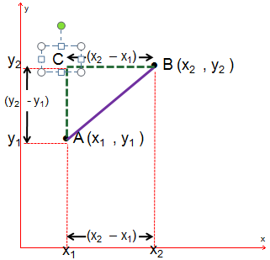

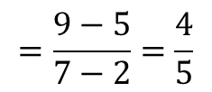
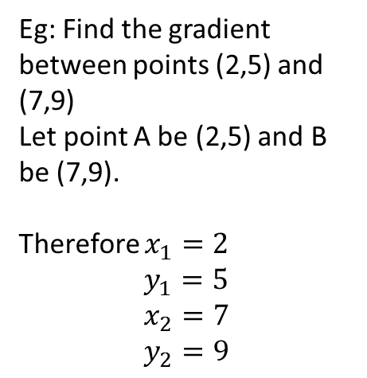
24
7
30
Date
Gradient, Distance & Midpoint
EQ – Describe how the gradient, distance & midpoint between two points are calculated using formulae?
Gradient (m)
Eg: Find the gradient between points (2,5) and (7,9)
Let point A be (2,5) and B be (7,9).
Therefore $x_{1}=2$ $$y_{1}=5 \\ x_{2}=7 \\ y_{2}=9$$
So m =
$$=\frac{9−5}{7−2}=\frac{4}{5}$$
So Gradient (m) = $\frac{4}{5}$

Slide 7
The Distance Formula
Let A (x₁ , y₁) and B (x₂ , y₂) be two points.
• B (x₂ , y₂)
D
A (x₁ , y₁) •
y₂ – y₁
x₂ – x₁
We often need to find d, the distance between A and B. This is found using PYTHAGORAS

Slide 8
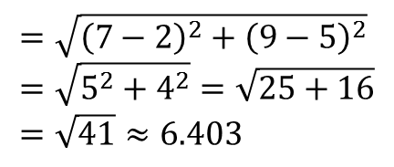
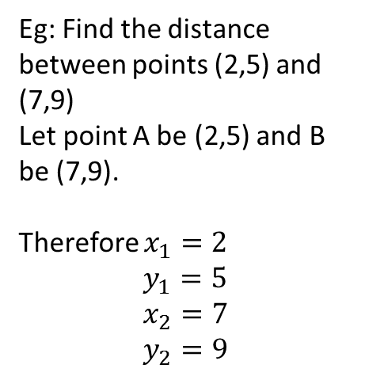
24
7
30
Date
Gradient, Distance & Midpoint
EQ – Describe how the gradient, distance & midpoint between two points are calculated using formulae?
Distance
Eg: Find the distance between points (2,5) and (7,9)
Let point A be (2,5) and B be (7,9).
Therefore $x_{1}=2$ $$y_{1}=5 \\ x_{2}=7 \\ y_{2}=9$$
$$=\sqrt{{\left(7−2\right)}^{2}+{\left(9−5\right)}^{2}} \\ =\sqrt{5^{2}+4^{2}}=\sqrt{25+16} \\ =\sqrt{41}≈6.403$$
So Distance = 6.40 to 2dp

Slide 9
The Midpoint Formula
Let A (x₁ , y₁) and B (x₂ , y₂) be two points.
• B (x₂ , y₂)
• M (? , ?)
• A (x₁ , y₁)
We often need to find M, the point halfway between A and B. This is called the MIDPOINT and its coordinates are found by averaging the x’s and averaging the y’s.

Slide 10
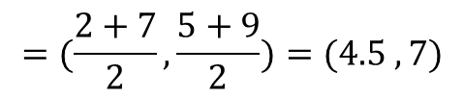
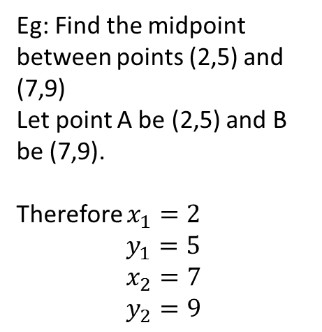
24
7
30
Date
Gradient, Distance & Midpoint
EQ – Describe how the gradient, distance & midpoint between two points are calculated using formulae?
Midpoint
Eg: Find the midpoint between points (2,5) and (7,9)
Let point A be (2,5) and B be (7,9).
Therefore $x_{1}=2$ $$y_{1}=5 \\ x_{2}=7 \\ y_{2}=9$$
$$=(\frac{2+7}{2},\frac{5+9}{2})=(4.5 , 7)$$
So Midpoint is = (4.5 , 7)

Slide 11
Questions Exercise 16.8 & 16.9 Pages 220 - 221

Slide 12
Notes Review
24, 7 ,30
Date
Title
Essential question
Notes complete
Notes complete with colour and diagrams
Questions completed
Contents page filed in
Formula page filled in

Slide 13
Homework
Review your notes and write a summary answering the essential question.

